Slide 1

McGraw-Hill Technology Education
Copyright © 2006 by The McGraw-Hill Companies, Inc. All rights reserved.

Slide 2
Chapter 11A
Database Management Systems

Slide 3
Database Management Systems
Database management system (DBMS)
Store large collections of data
Organize the data
Becomes a data storage system
11A-<number>
Notes:
Discussion point
Ask your student if anyone knows why sorting by zip code is important. Hopefully, someone knows that the post office provides a discount on presorted mail.

Slide 4
The Database
Stores a collection of related items
Collection is arranged in a structure
  Organizes and describes the data
Often includes helper documents
Two different types
11A-<number>
Notes:
Teaching tip
Figure 11A.2 on page 423 describes the database structure

Slide 5
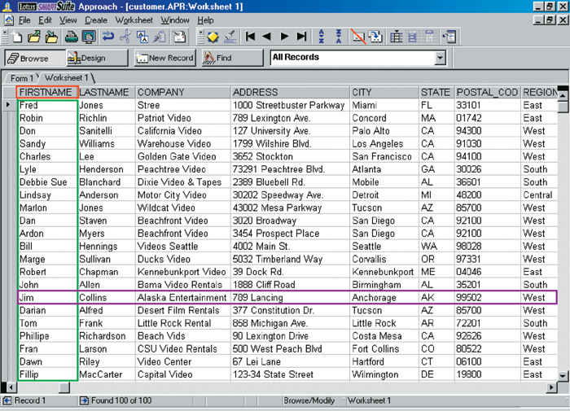
Database Structure
Field Name
Field
Record
11A-<number>

Slide 6
The Database
Fields
  Hold an individual piece of data
  Are named descriptively
  Often called a column
  Phone book examples
    Name, address, e-mail, phone number
  Fields may contain no data
11A-<number>

Slide 7
The Database
Records
  One full set of fields
  Often called a row
  Phone book example
    Smith, Joe, 123 Some Street, 412-555-7777
  Databases may have unlimited rows
11A-<number>

Slide 8
The Database
Tables
  One complete collection of records
  Databases may have thousands of tables
11A-<number>

Slide 9
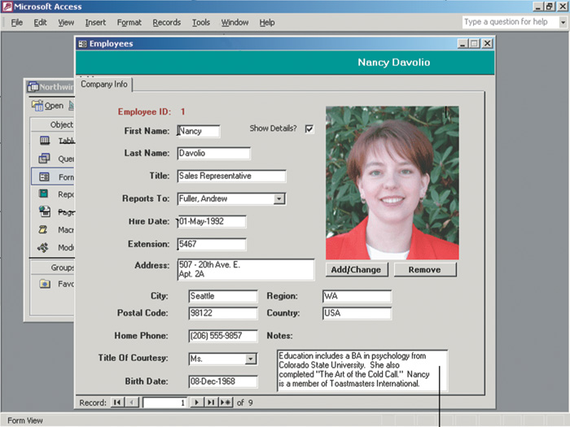
Database Helper Documents
Forms
  Present one record to the user
  Often used to change or view data
11A-<number>
Notes:
Teaching tip
Figure 11A.3 on page 423 provides examples of forms and reports.

Slide 10
Database Helper Documents
Reports
  Produce printed results from the database
  Includes tools to summarize data
11A-<number>

Slide 11
Flat-file Databases
Typically has only one table
  If multiple, each has a separate file
Useful for simple data storage needs
Hard to manage large data needs
Can waste disk space
11A-<number>
Notes:
Teaching tip
Start your students thinking about real databases, with millions of records. Using PA instead of Pennsylvania saves 10 bytes per record. In a database with 1 million records, this saves 10,000,000 bytes. This is roughly equal to a stack of 10 floppy disks

Slide 12
Relational Databases
Made of two or more tables
Tables are related by a common field
  Called a relationship or join
  Can help organize data
Most common form of database
Maintaining data is easier than flat-file
No wasted disk space
11A-<number>
Notes:
Teaching tip
To demonstrate the power of relationships, setup a flat file database with music, artists, CD and year released. Demonstrate how difficult and wasteful it is to store several songs by the same artist and CD. Be sure to make several typing mistakes. Then build the same structure relationally. Create music, artist and CD tables. Join the artist and CD to the music table. Now show how easy it is to add songs from the same CD. While creating this database, it helps to use music the students know.

Slide 13
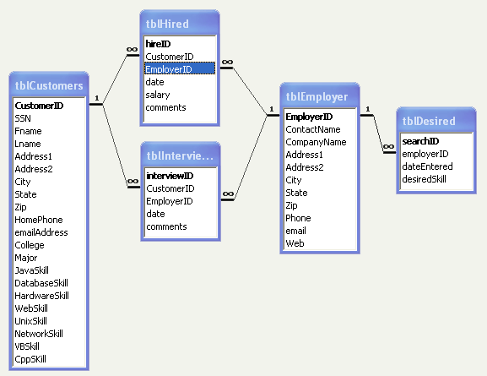
ER Diagram
11A-<number>

Slide 14
The DBMS
Programs that control the database
Allows
  Entering data
  Querying data
  Printing reports
Supports thousands of users
Includes tools to protect the data
11A-<number>
Notes:
Teaching tip
Protecting databases is similar to network administration, covered in chapter 9. Access to read and change data is limited to a list of allowed users.

Slide 15
Working with a Database
Creating tables
  List the necessary fields
  Steps to define a field
    Descriptively name the field
    Specify the field type
    Determine the field size
11A-<number>

Slide 16
Working with a Database
Field types
  Describes the type of data stored
  Most DBMS use the same types
    Text fields store letters and numbers
    Numeric field store numbers
    Date and time field
    Logical field stores yes or no
    Binary field stores images or sounds
    Counter field generates sequential numbers
    Memo fields store large amounts of data
11A-<number>
Notes:
Teaching tip
Dates are stored sequentially in a database. 0 is January 1, 1970 at midnight. 1 is one millisecond after midnight on January 1, 1970. Each date represents the number of milliseconds from January 1, 1970.

Slide 17
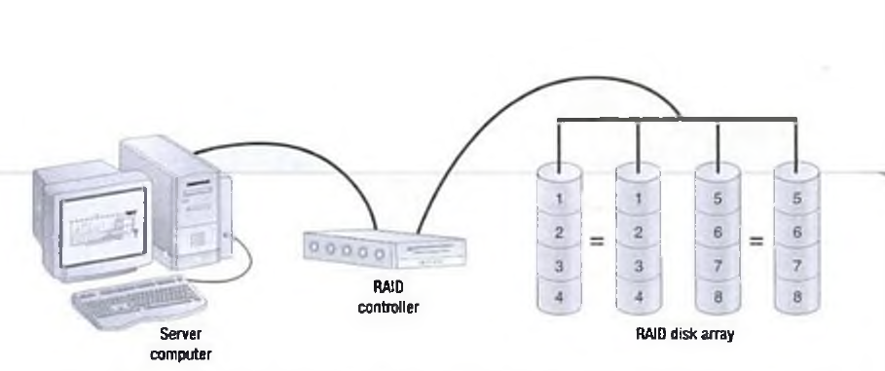
Working with a Database
11A-<number>
Notes:
Teaching tip
Dates are stored sequentially in a database. 0 is January 1, 1970 at midnight. 1 is one millisecond after midnight on January 1, 1970. Each date represents the number of milliseconds from January 1, 1970.

Slide 18
Working with a Database
Entering data into a table
  Users type data into a field
  Data must be entered accurately
    Constraints help to verify data
  Forms are typically used for data entry
11A-<number>

Slide 19
Working with a Database
Viewing records
  Datasheet view shows all records
  Filters can limit the records shown
    Display only records matching a criteria
  Forms allow viewing one record
11A-<number>

Slide 20
Working with a Database
Sorting records
  Order records based on a field
  Multiple sub sorts resolve ‘ties’
  Several types of sorts
    Alphabetic
    Numeric
    Chronological
    Ascending
    Descending
11A-<number>
Notes:
Teaching tip
Using a DBMS, demonstrate the power of sorting for the class.

Slide 21
Working with a Database
Querying a database
  Statement that describes desired data
  List of fields can be modified
  Uses of querying
    Find data
    Calculate values per record
    Delete records
  Most important DBMS skill
11A-<number>
Notes:
Teaching tip
Page 432 and 433 show examples of the different querying languages.

Slide 22
Working with a Database
Query languages
  All DBMS use a query language
    Most DBMS modify the language
  Structured Query Language (SQL)
    Most common query language
  xBase
    Query language for dBase systems
  Query by example (QBE)
    Interface to SQL or xBase
    Interactive query design
11A-<number>

Slide 23
Query Examples
SQL
  Select FirstName, LastName, Phone
  From tblPhoneNumbers
  Where LastName=“Norton”;
xBase
  Use tblPhoneNumbers
  List FirstName, LastName, Phone
  For LastName=“Norton”
11A-<number>

Slide 24
Working with a Database
Generating reports
  Printed information extracted from
  a database
  Can calculate data
    Calculate data per row
    Calculate for entire table
  Pictures and formatting can be included
11A-<number>

Slide 25
Chapter 11A
End of Chapter

